Slide 1
World Happiness Report K-Means Clustering
Project #2
Minh Truong & Mallie Lange
Notes:
This project applies K-Means clustering, an unsupervised machine learning algorithm, to the World Happiness Report 2024 dataset, to identify natural groupings among countries based on six key happiness indicators.

Slide 2
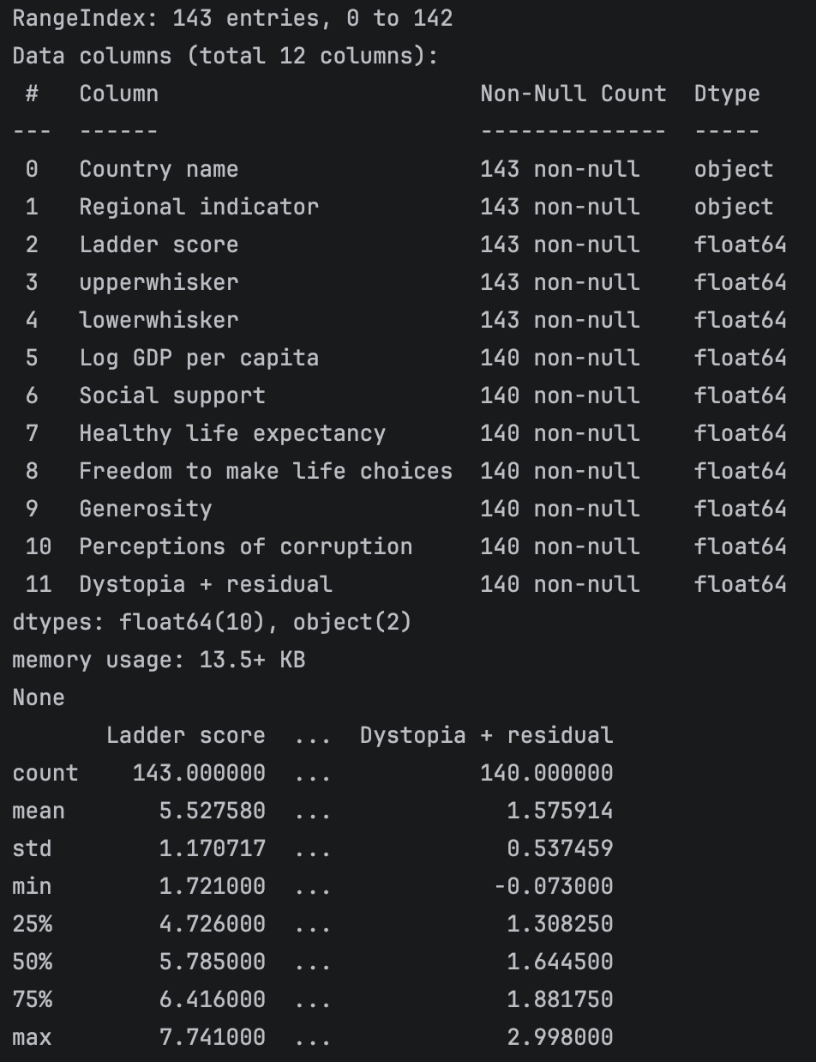
Dataset Information + K-Means Clustering
The dataset was chosen from kaggle.com.
The World Happiness Report is a survey of global happiness. The six factors are: economic production, social support, life expectancy, freedom, absence of corruption, and generosity. Each row represents the average scores for that specific country. The overall happiness score (the ladder score) is the sum of six factors and the ‘dystopia + residual’.
We chose to utilize the unsupervised learning method of K-Means clustering to group the countries based on similarities across the multiple factors.
Notes:
The World Happiness Report 2024 includes 143 countries evaluated across six indicators: GDP per capita, social support, healthy life expectancy, freedom, generosity, and perceptions of corruption. Unsupervised learning algorithms use unlabeled data to identify patterns or groupings without predefined outputs. K-Means clustering was selected because the dataset contains no predefined labels, making unsupervised learning the most suitable approach for identifying natural groupings among countries.

Slide 3
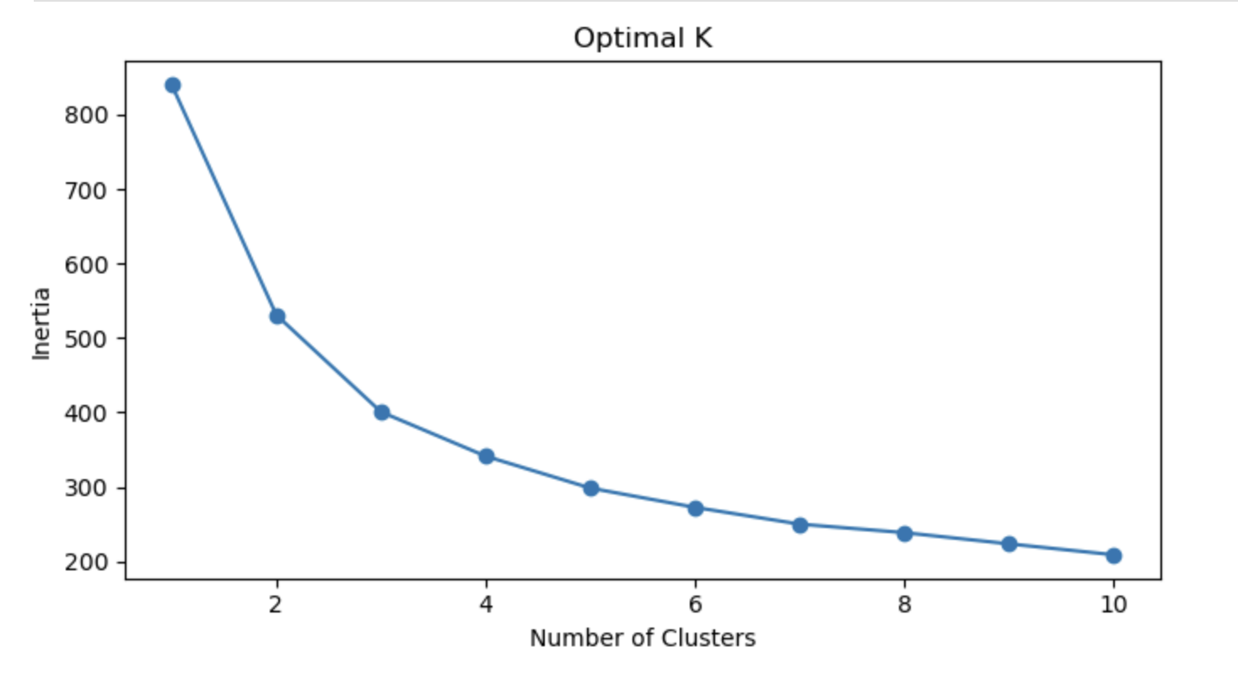
K-Means Clustering - Elbow Method
Using the Elbow method, we chose three clusters of best grouped countries based on the factors.
The three clusters are:
High levels of happiness: Countries that are doing really well in terms of strong economies, good healthcare, lots of social support and people feel more free
Moderate levels of happiness: Countries that are going okay with a moderate quality of life and mixed results for the features
Low levels of happiness: Countries that are not doing very well with lower incomes, weaker healthcare, and less social support
Notes:
The elbow method tested k=1 through k=10 and identified k=3 as the optimal number of clusters where inertia begins to flatten. The three clusters represent low, medium, and high happiness countries, differentiated primarily by GDP per capita and social support.

Slide 4
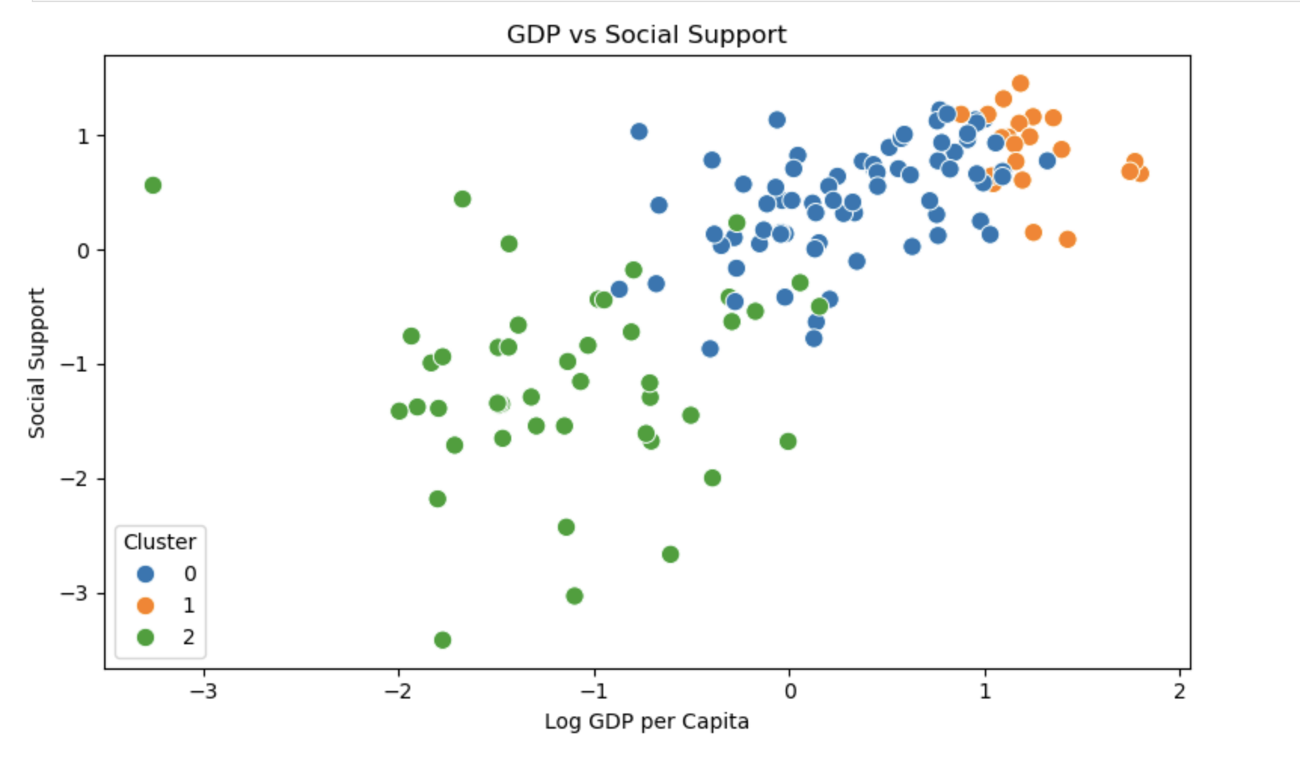
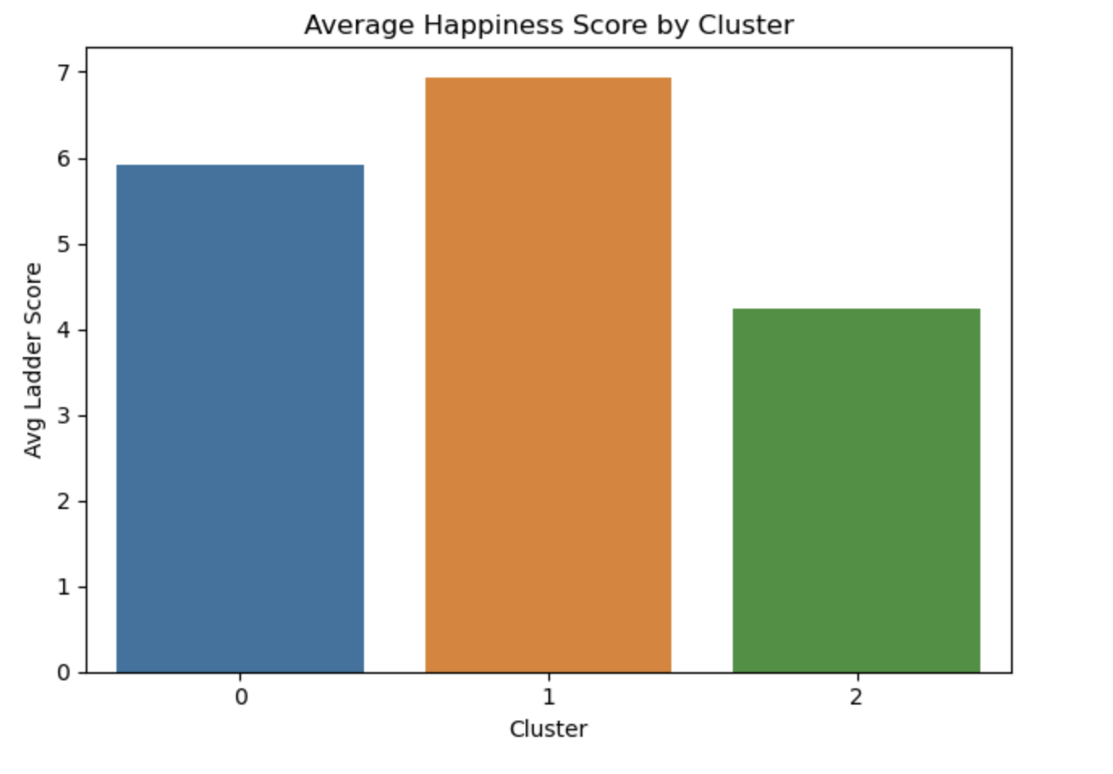
Visualization + Conclusion
The scatter plot shows countries grouped into three clusters based on their log GDP per capita and social support, with each color representing one of the clusters. This scatterplot is one example of how the countries naturally are clustered.
The bar chart validates the cluster labels by comparing average ladder scores, where Cluster 1 ranks highest (~6.95), Cluster 0 falls in the middle (~5.95), and Cluster 2 ranks lowest (~4.25). Using K-Means clustering with k=3, 143 countries were grouped into three happiness segments: high, medium, and low, with GDP per capita and social support identified as the primary differentiating factors.
Notes:
The scatter plot shows countries grouped into three clusters based on their log GDP per capita and social support. Itshows clear separation between the three clusters confirming that the aforementioned are the strongest differentiators of national happiness. Countries with higher GDP and stronger social systems consistently fall in the high happiness cluster, while lower-income nations with weaker support systems cluster fall in the low happiness cluster.

